Slide 1
Data analyze for Covid-19 dataset - Johns Hopkins University Based on Spark and Hadoop
Instructor:
Dr. Abedalrhman Alkhateeb
Presenters:
1220872 – Thi Thuy Tien Tran
1223822 – Yiming Liu
1221372 - Xiaofan Wang

Slide 2





Architecture of project
Packages we are using:
OS: Ubuntu 22.04
Java JDK 11
Hadoop: 3.3.6
Spark: 3.5.0
hd-slave01
172.20.10.13
hd-master
172.20.10.3
hd-slave02
172.20.10.5

Slide 3
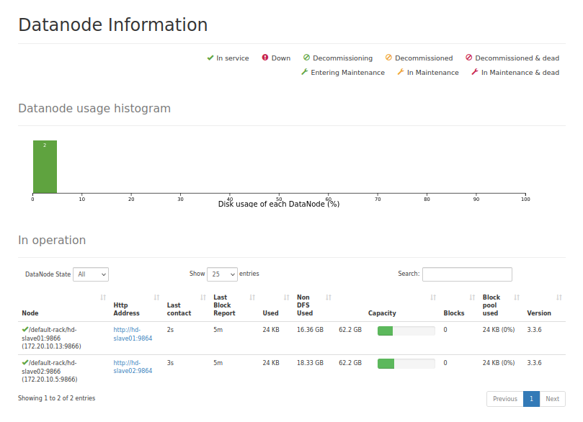
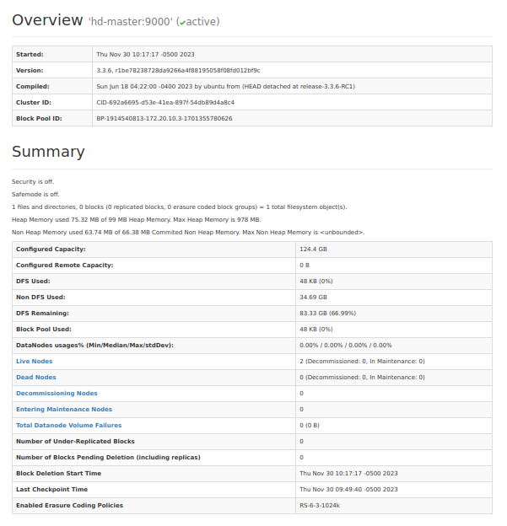
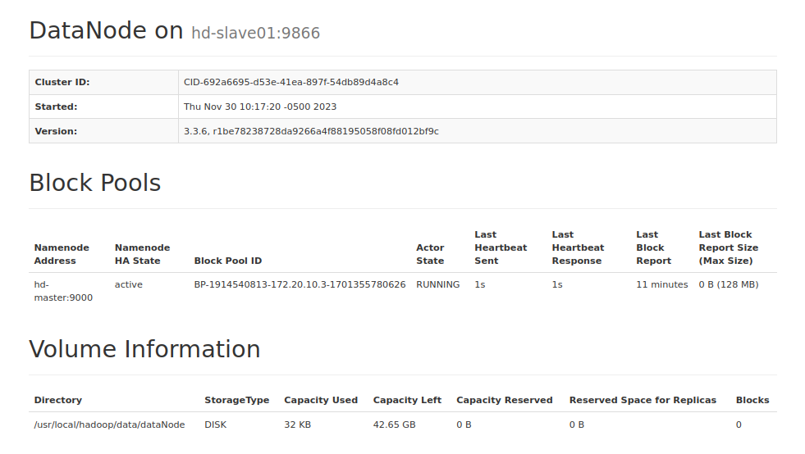
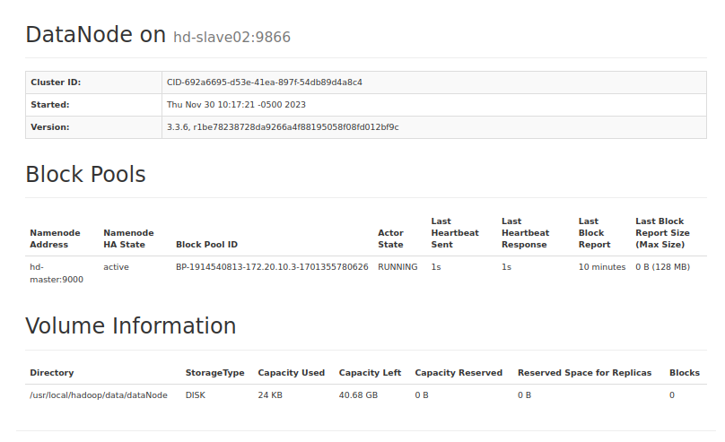
Architecture of project
Hadoop Cluster
http://hd-master:9870/dfshealth.html#tab-datanode
http://hd-slave01:9864/datanode.html
http://hd-slave02:9864/datanode.html
http://hd-master:9870

Slide 4
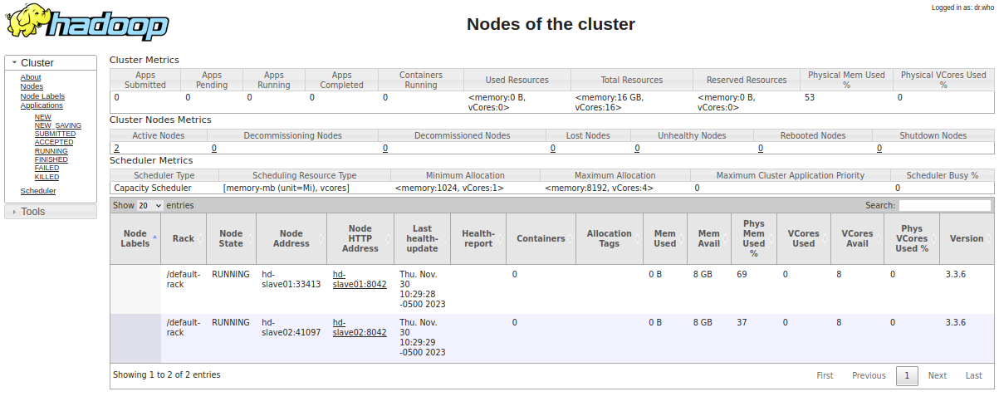
Architecture of project
http://hd-master:8088

Slide 5
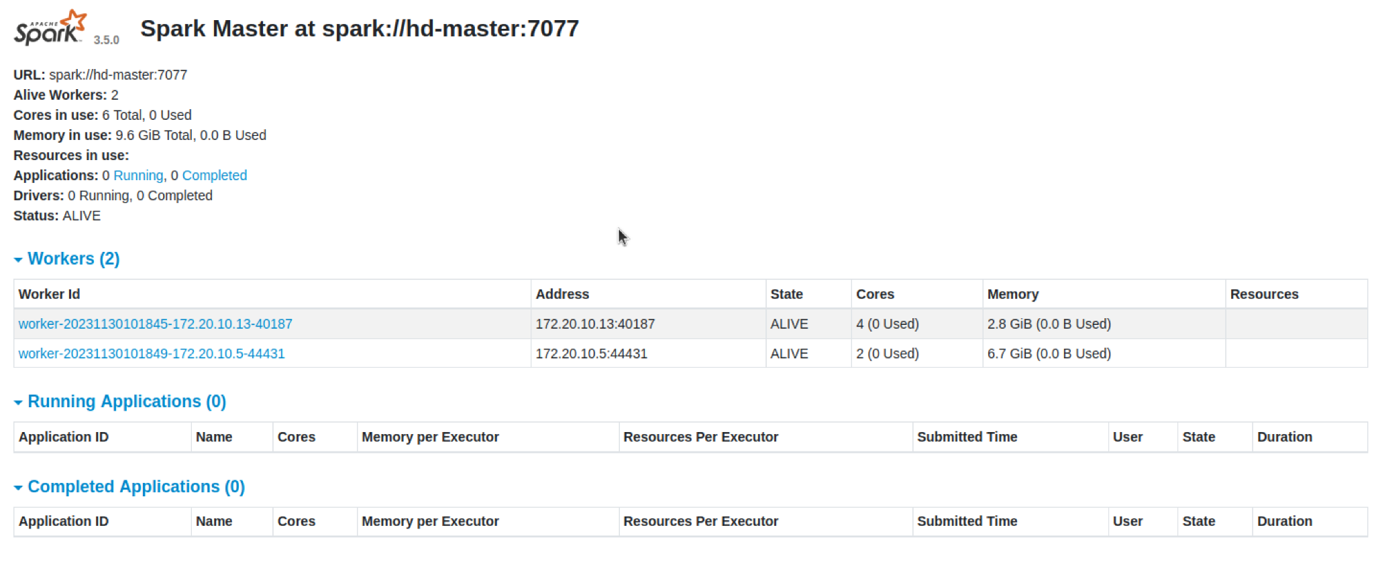
Architecture of project
Spark Clusters
http://hd-master:8080

Slide 6
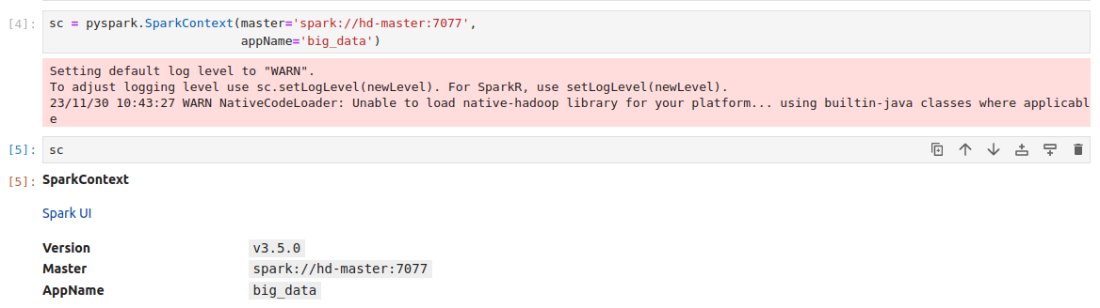
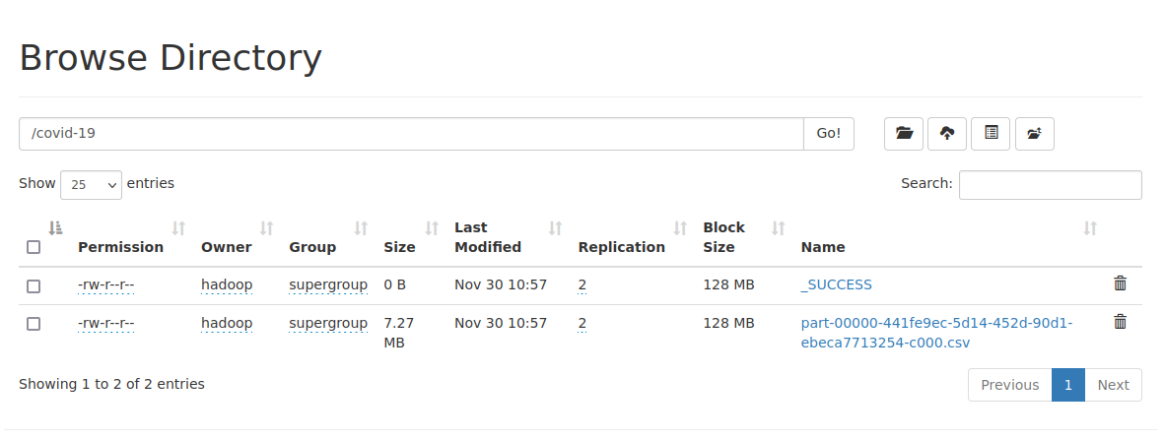

Slide 7
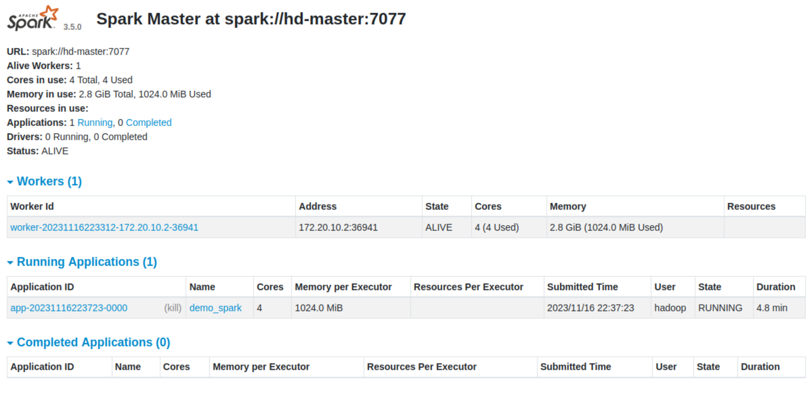
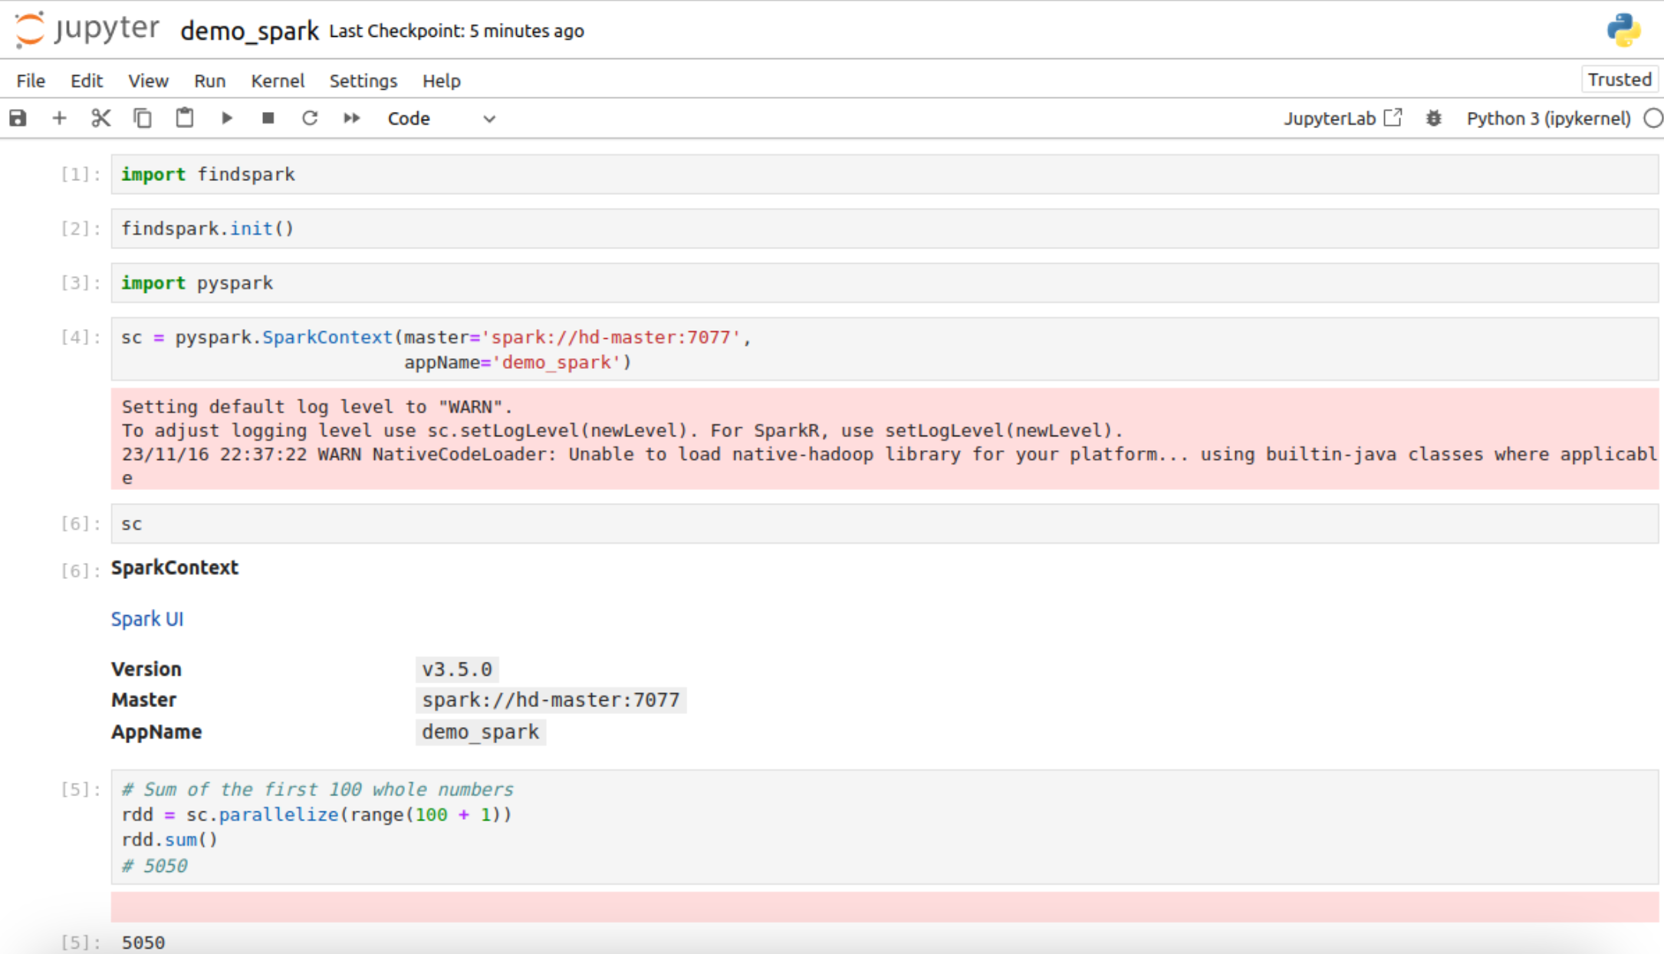
Integrate Spark with Jupyter Notebook
On Master Node
Install Jupyter Notebook
Install pyspark
Install findspark
http://hd-master:8080

Slide 8
Dataset
Covid-19 dataset - Johns Hopkins University
Repo: https://github.com/CSSEGISandData/COVID-19
Why Big Data characteristics?
Volume: more than 400,000 records every day in more than 100 days
Velocity: data is updated daily
Visualization: information is extracted by visualizing data
System Description
HDFS: store raw data
Spark SQL + Dataframes: retrieve and visualize data
Spark MLLib: build model to predict cases on specific date

Slide 9
Workflow
Data Preprocessing (Tien)
Export to csv
Save to hdfs
Data Visualization (May)
Data visualizations
Data Modelling (Xiaofan)
Time series data

Slide 10
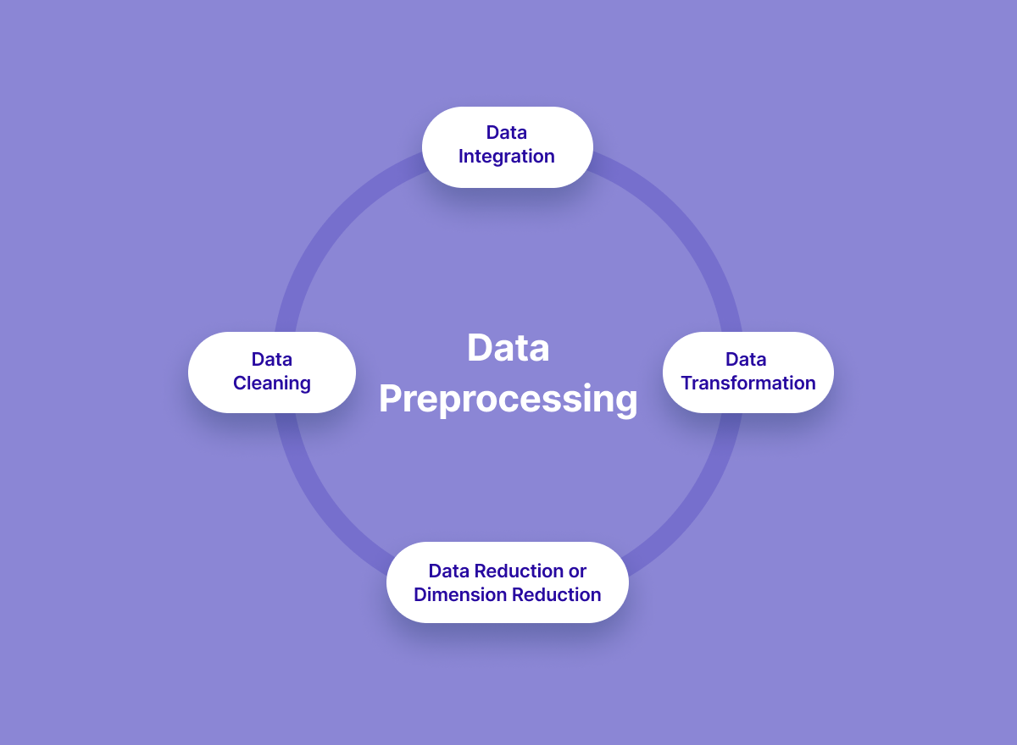

Data Preprocessing
Why Data Preprocessing?
Data preprocessing is vital.
We've specifically removed non-country areas, focusing our analysis on relevant regions, thereby improving accuracy and reducing noise for more meaningful insights. This strategic preprocessing step ensures the precision and relevance of our findings in understanding the impact of COVID-19 at the country level. And also for better visualization and model learning.

Slide 11
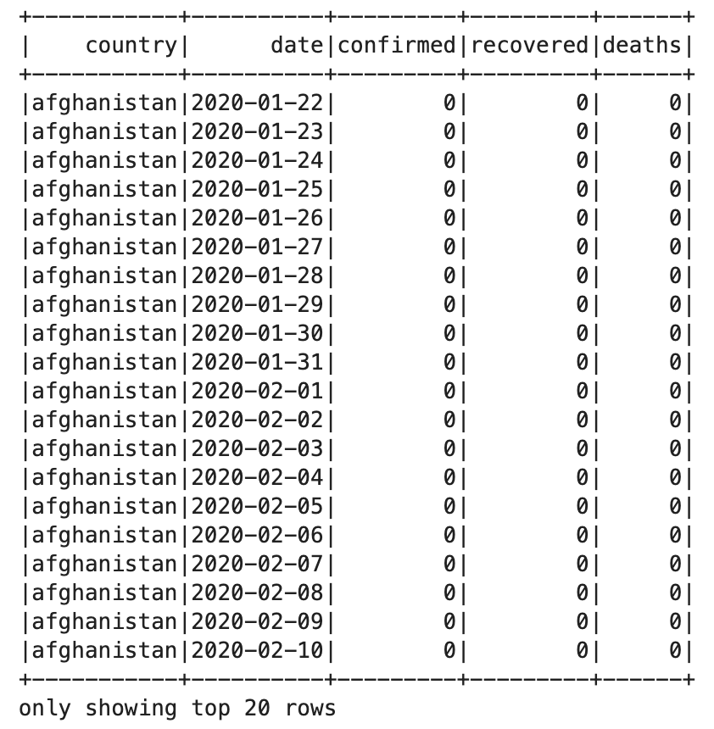
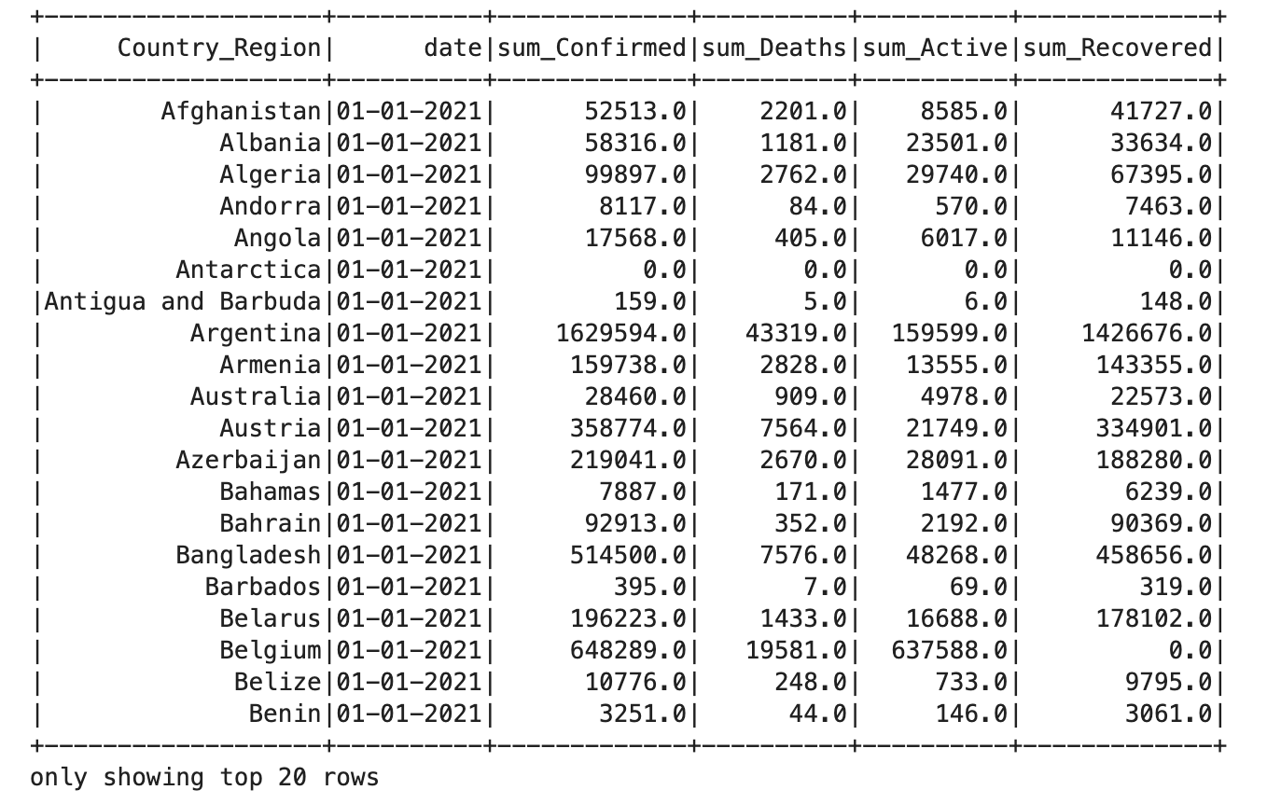
Data Preprocessing
After preprocessing, We have total data for (224029, 5)
In total 196 countries for 1143 days data for covid-19 confirmed/recovered/deaths.

Slide 12


Data Visualization
Why visualize the data?
Visualizations enhance clarity, aid in pattern recognition, facilitate effective comparisons, support decision-making, and engage diverse audiences. In the context of our analysis, they serve as a powerful tool for unraveling the dynamics of the pandemic and communicating findings with impact.
How to achieve that?
Based on the preprocessing data, mainly using PySpark as DataFrame to process specific data and using pandas lib to visualize the data.

Slide 13
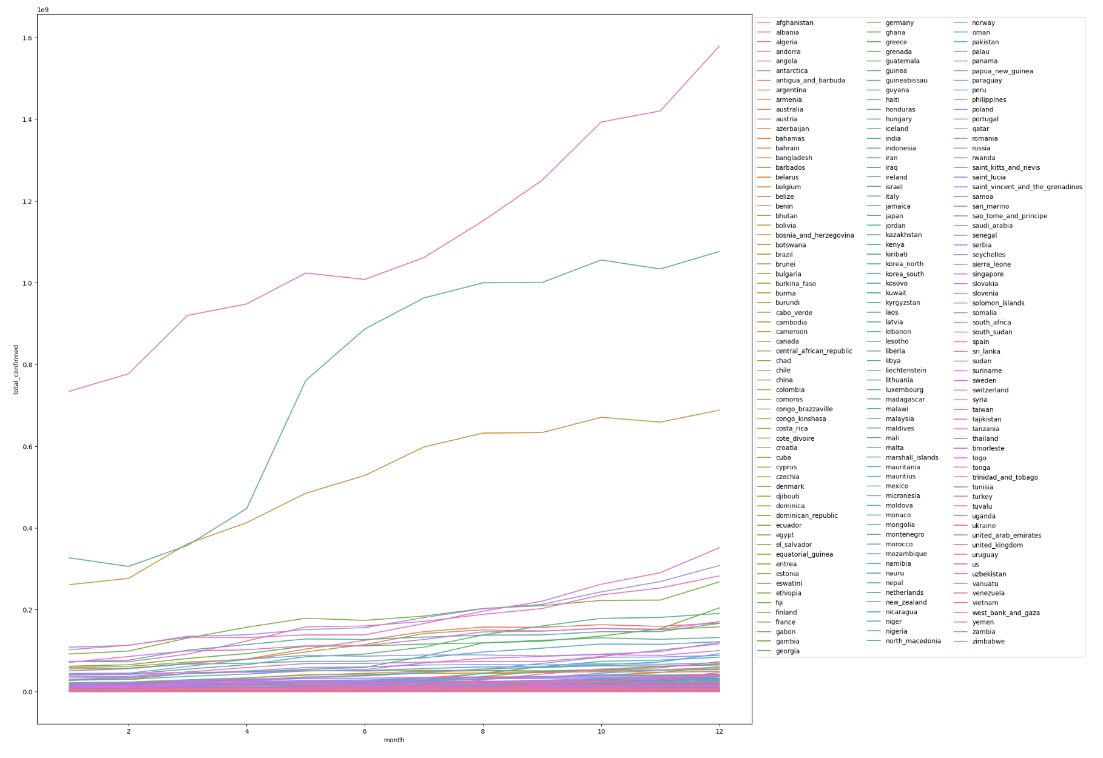
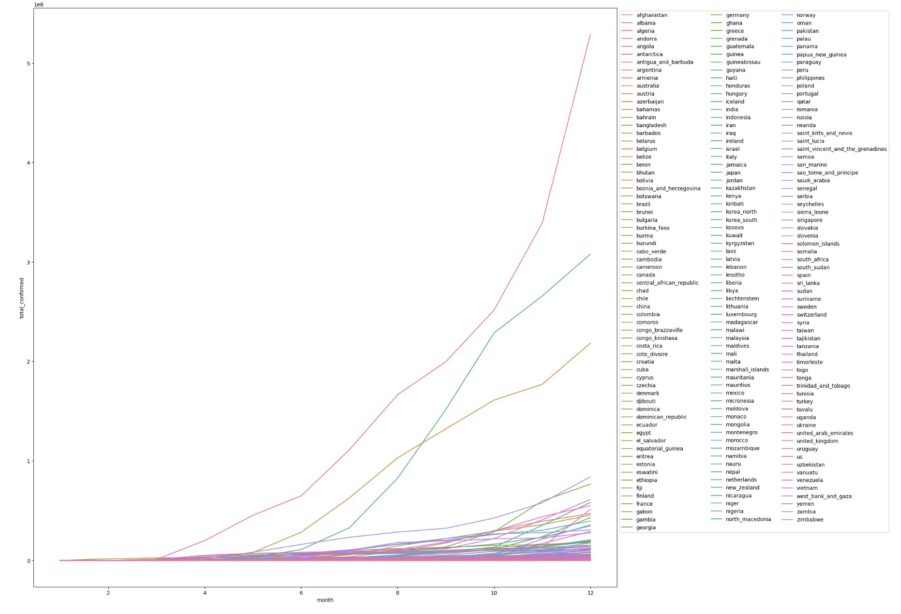
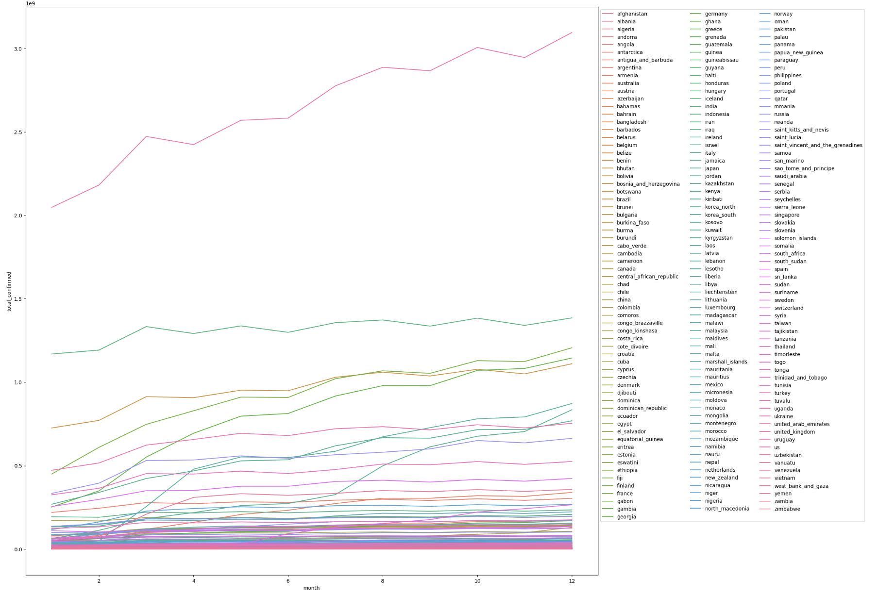
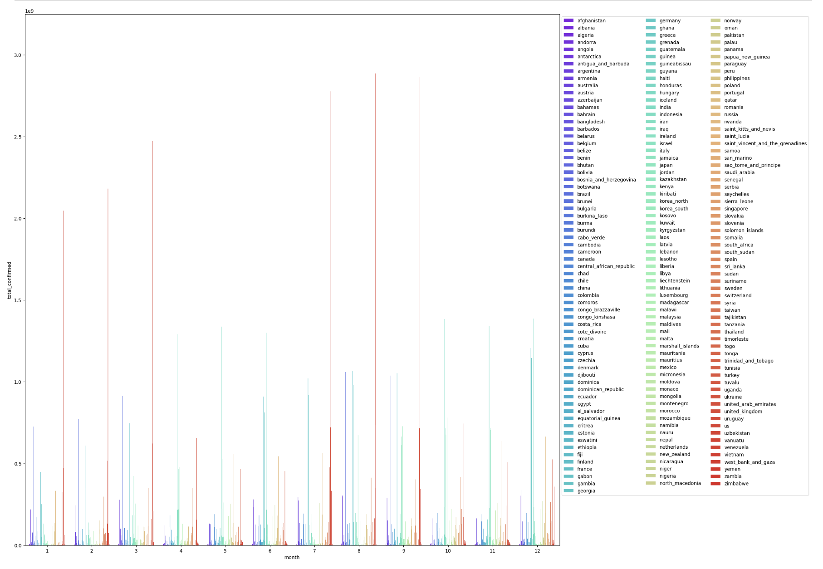
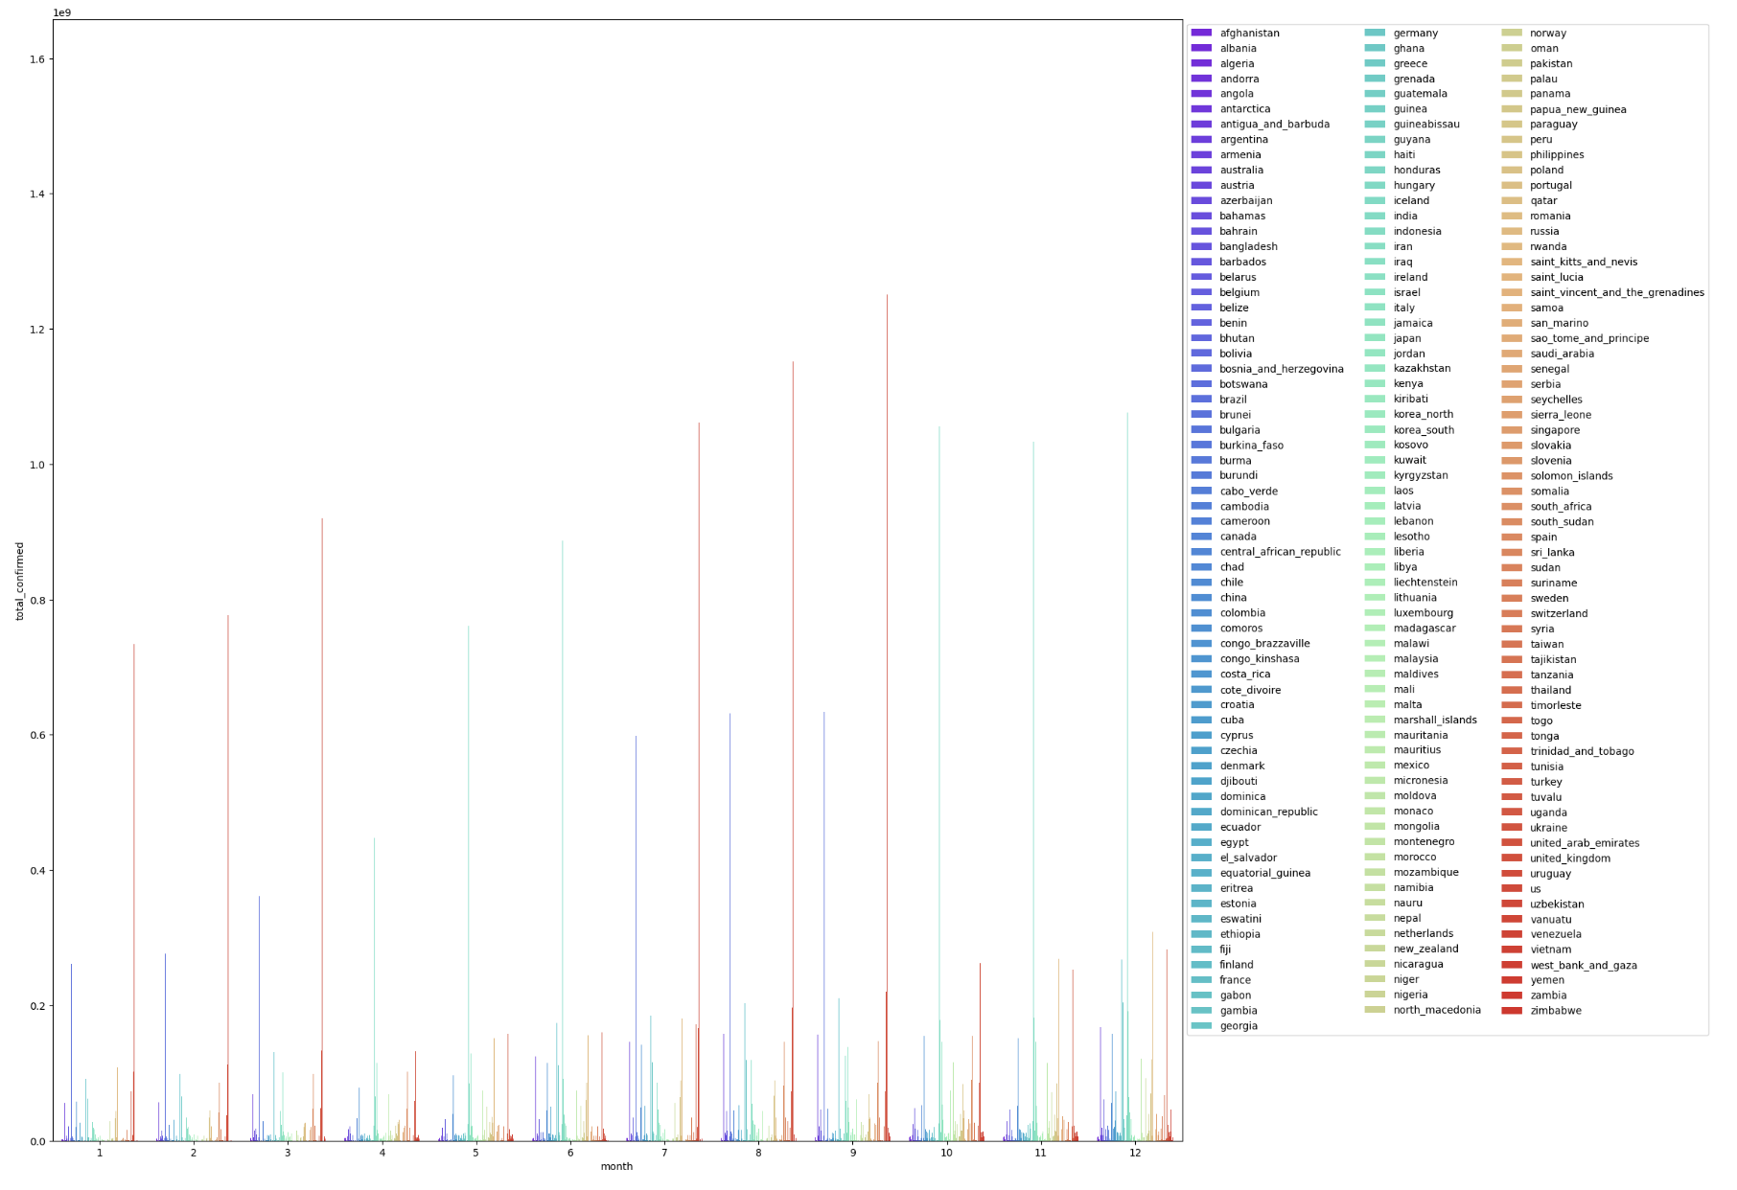
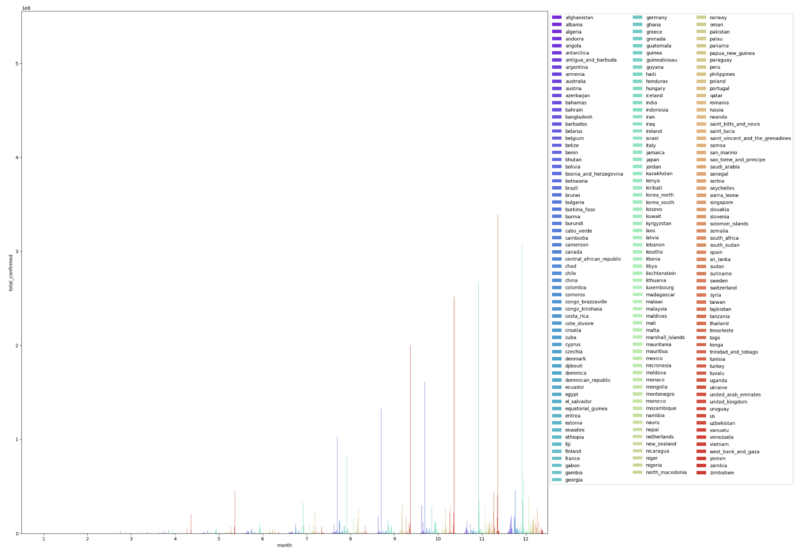
Overall confirmed data for Each Country (Area) by years
Showing left is the every country (area)’s confirmed cases in 2020/2021/2022 by month.
In this figure, we can see the overall trend of Covid-19 situation around the world.

Slide 14
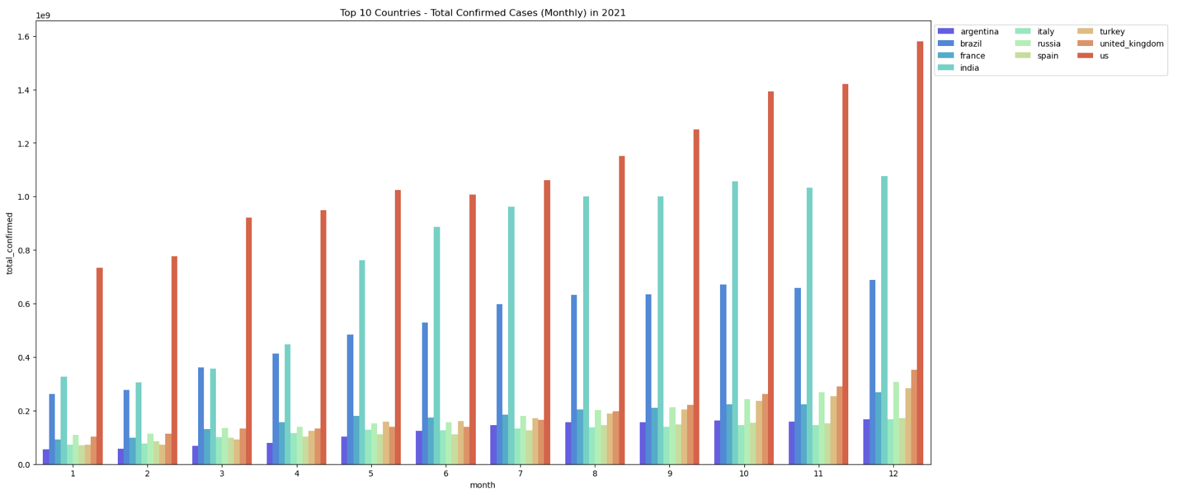
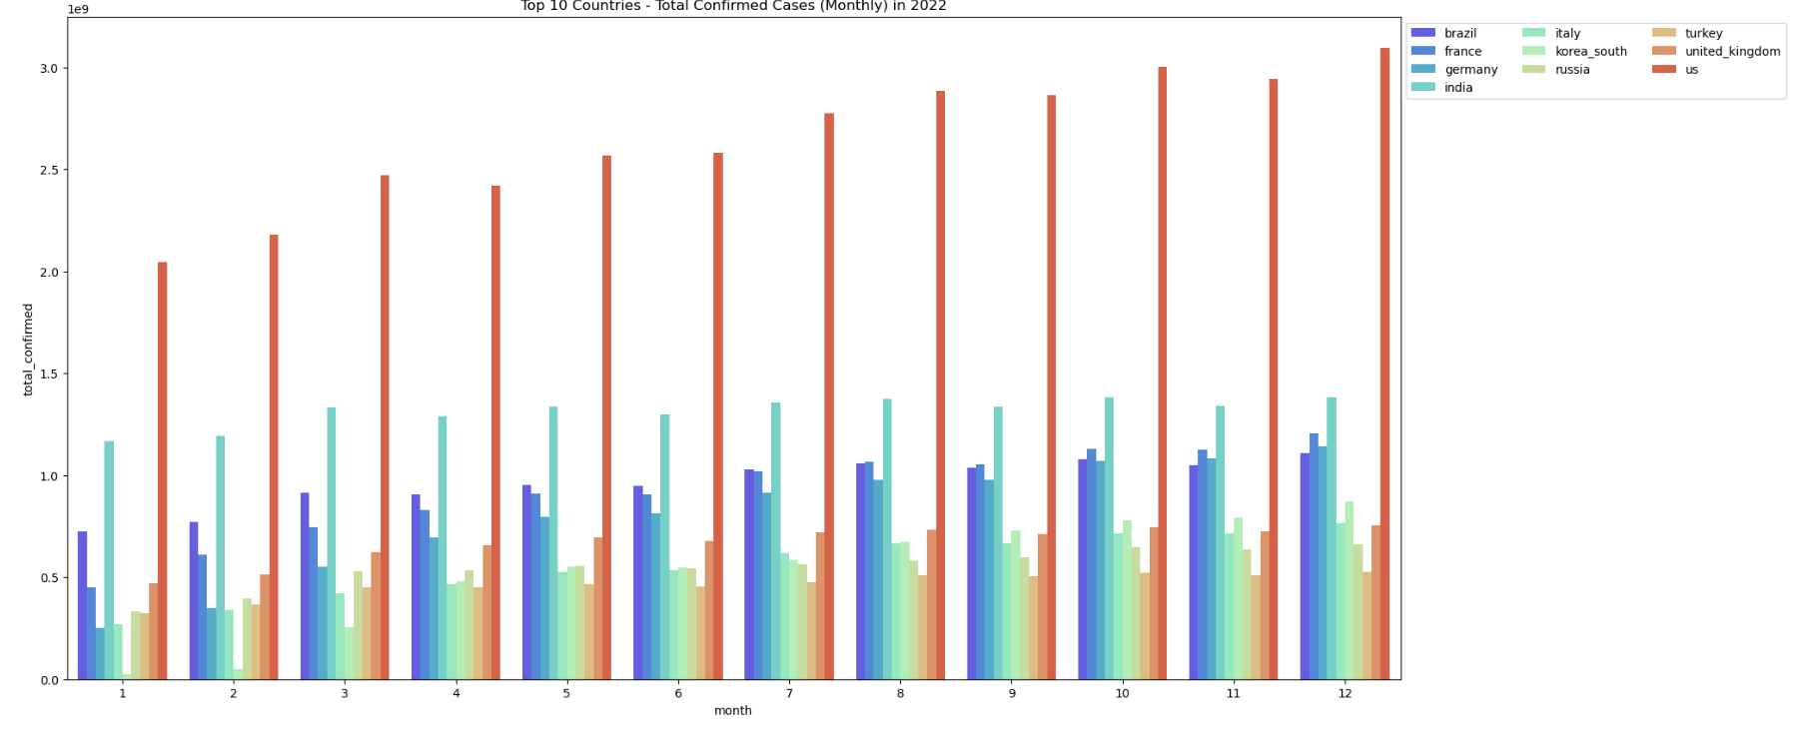
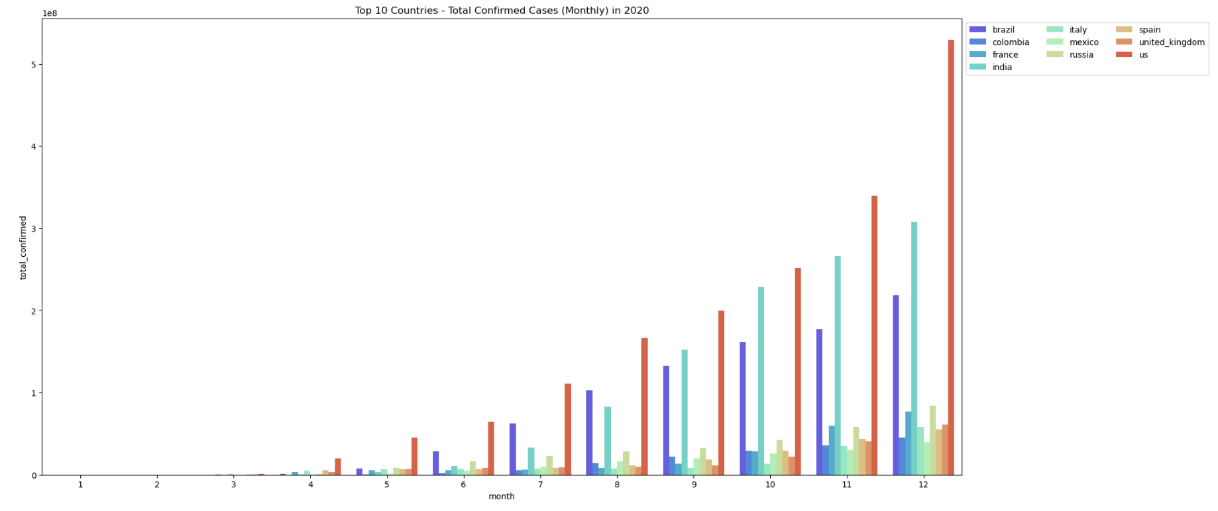
Top 10 Countries in 2020/2021/2022

Slide 15
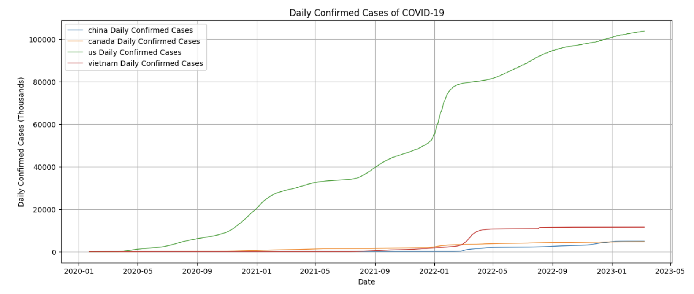
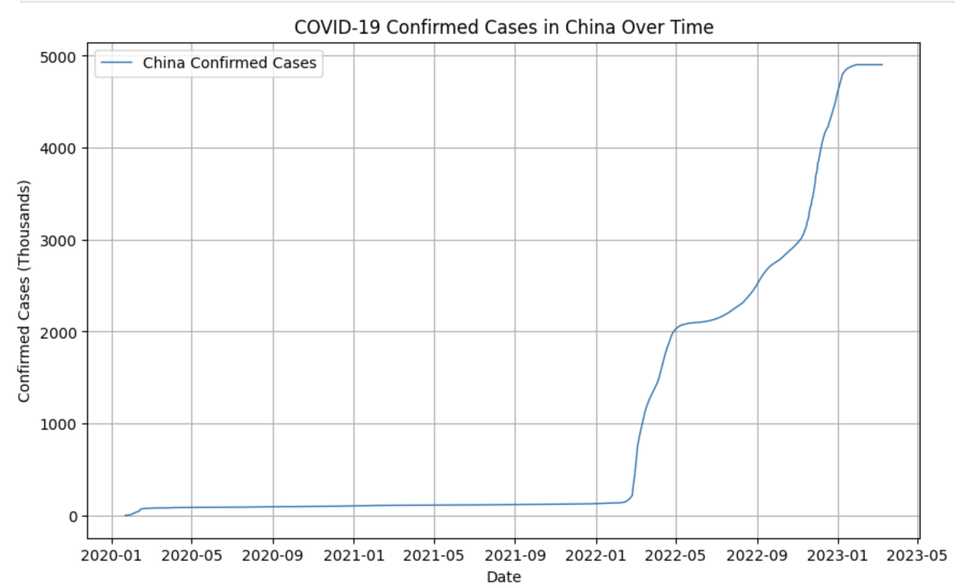
Dive into one or selected countries
We can select any countries we want, for better compare and view

Slide 16
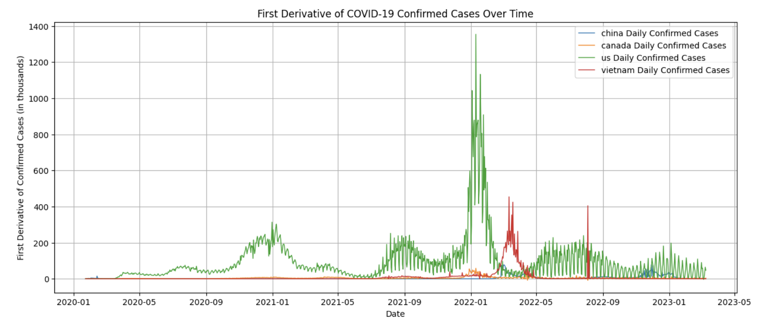
First Derivative
The first derivative of a function represents the rate at which the function is changing. In the context of COVID-19 confirmed cases, taking the first derivative of the case numbers over time provides the rate of change of new cases. This can be a valuable metric for understanding the dynamics of the pandemic and assessing its progression.

Slide 17
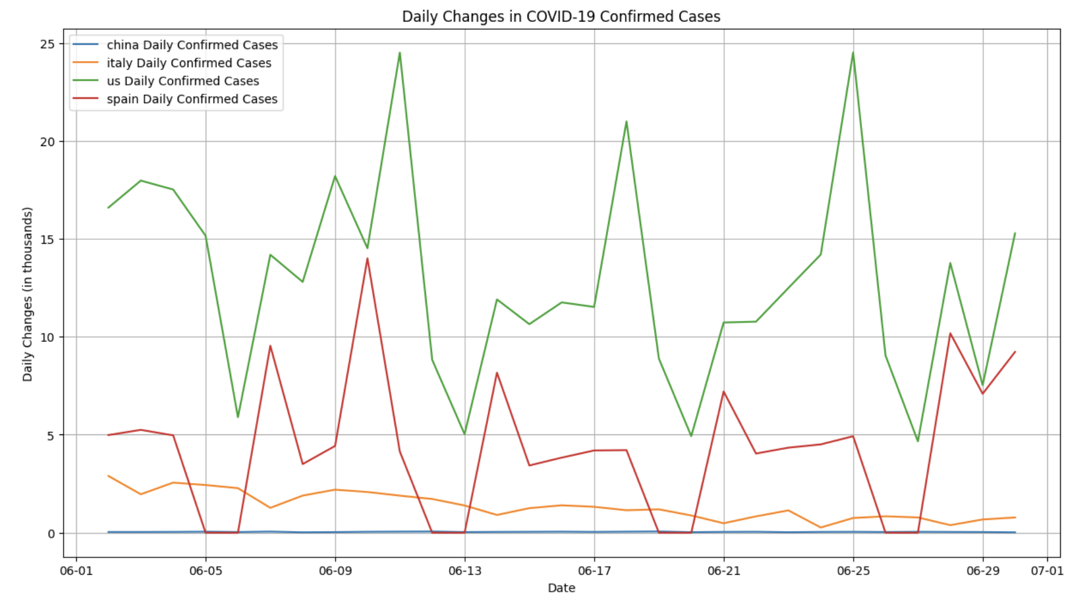
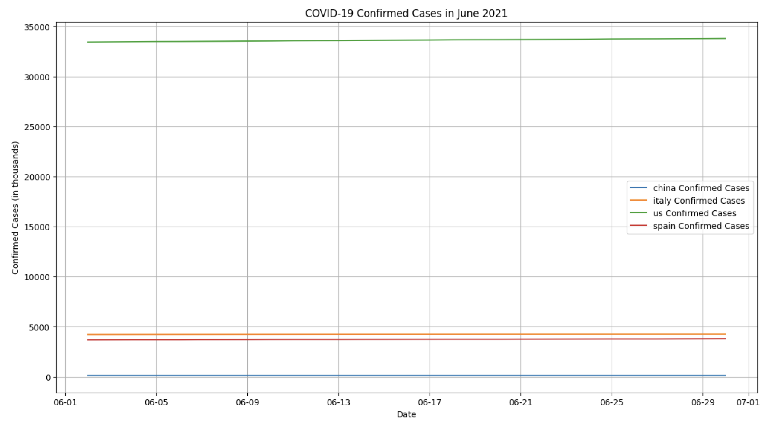
Choose any one month of selected countries

Slide 18
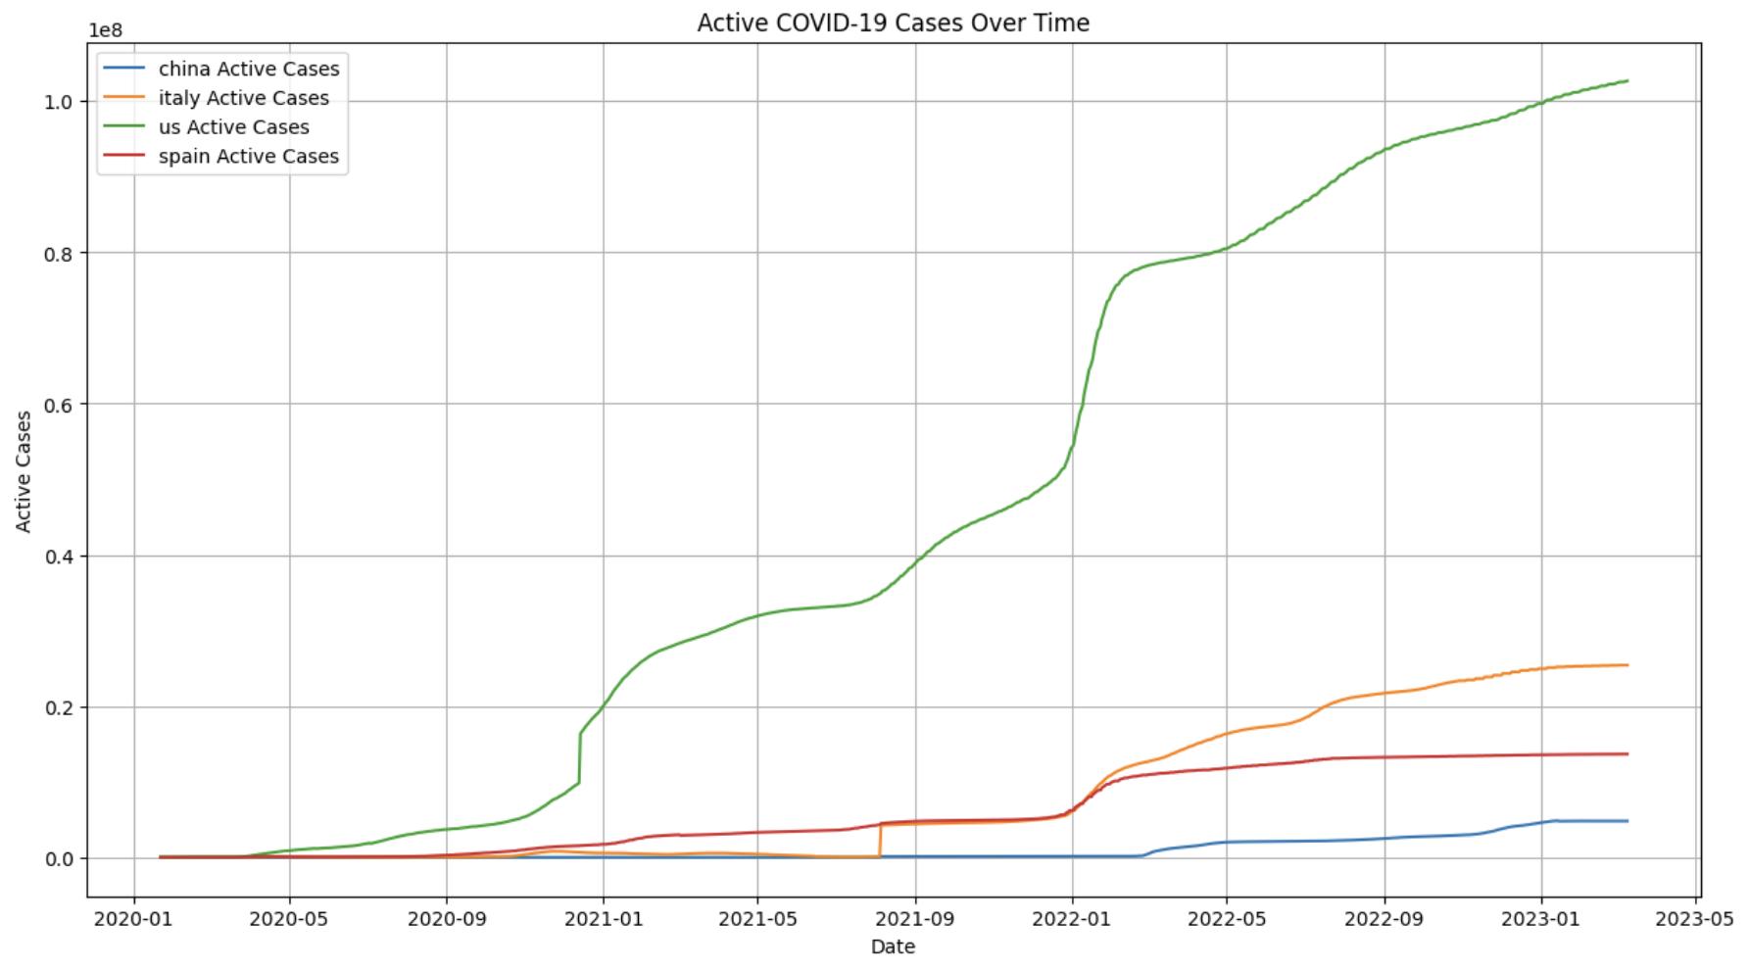
Active COVID-19 Cases
Active cases represent the total number of individuals currently infected and potentially capable of transmitting the virus. Monitoring active cases is crucial for resource allocation and public health planning.
A rise in active cases may indicate increased transmission, while a decline suggests control measures are working. The number of active cases influences the burden on healthcare systems and the potential for community transmission. This metric is vital for assessing the current state of the pandemic and informing decisions on containment measures.
("active_cases", F.col("confirmed") - F.col("recovered") - F.col("deaths"))

Slide 19
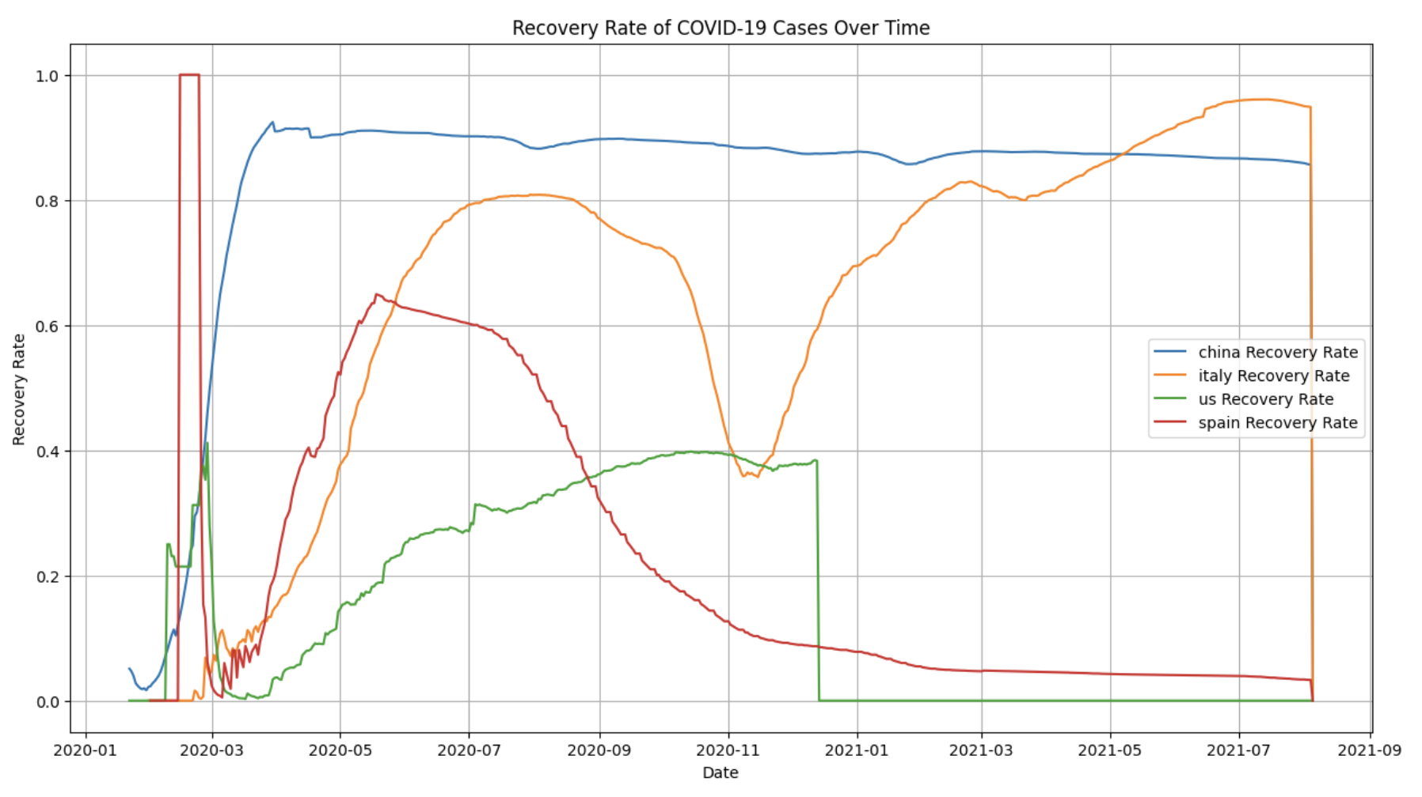
Recovery Rate
The recovery rate represents the proportion of confirmed cases that have recovered from the illness. It is a key indicator of the healthcare system's capacity to manage and treat COVID-19 cases.
A high recovery rate indicates that a significant percentage of individuals diagnosed with COVID-19 are successfully recovering. Monitoring changes in the recovery rate over time can provide insights into the effectiveness of healthcare interventions, treatment protocols, and the overall resilience of the healthcare system.
(Recover data ends collected on 2021/08/05 for all countries)
("recovery_rate", F.col("recovered") / F.col("confirmed"))

Slide 20
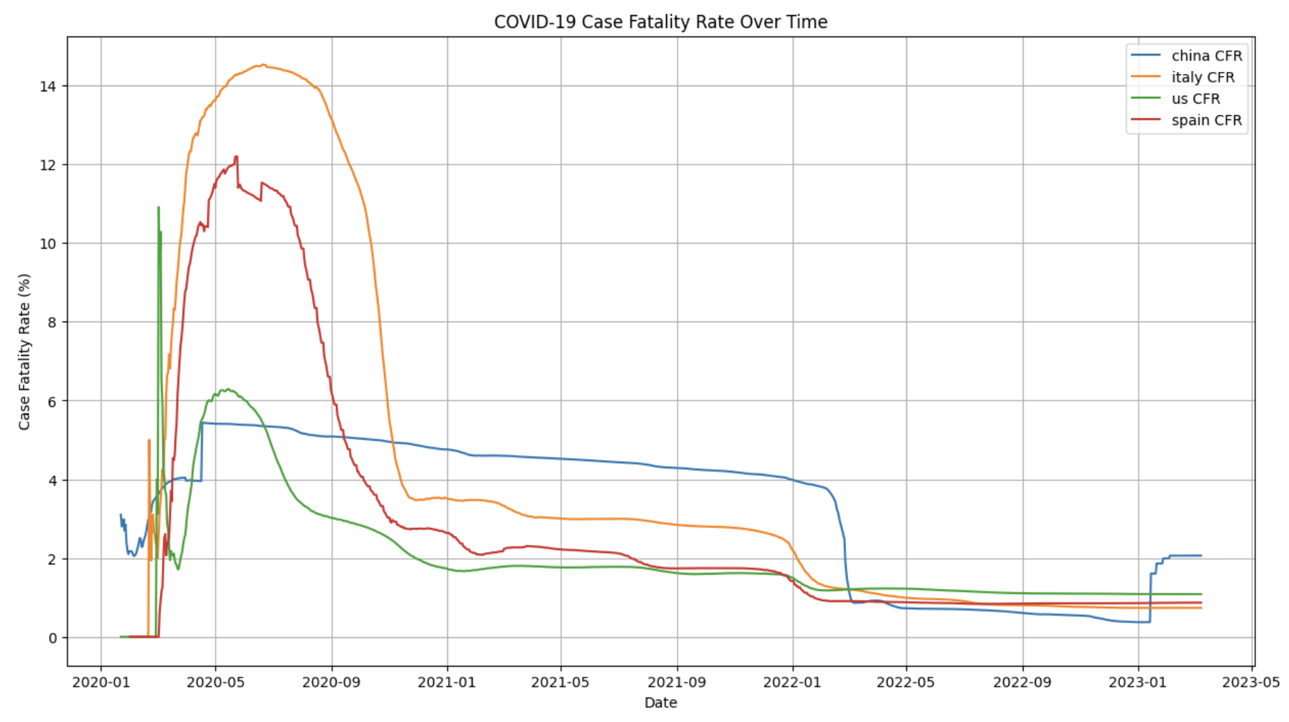
Case Fatality Rate (CFR)
CFR calculates the percentage of confirmed cases that result in death. It is a critical metric for assessing the severity and lethality of the disease.
A high CFR may suggest that the healthcare system is overwhelmed or that the virus is particularly lethal. A decreasing CFR over time can indicate improvements in medical treatments, increased testing and detection of milder cases, or a change in the demographic profile of those infected.

Slide 21
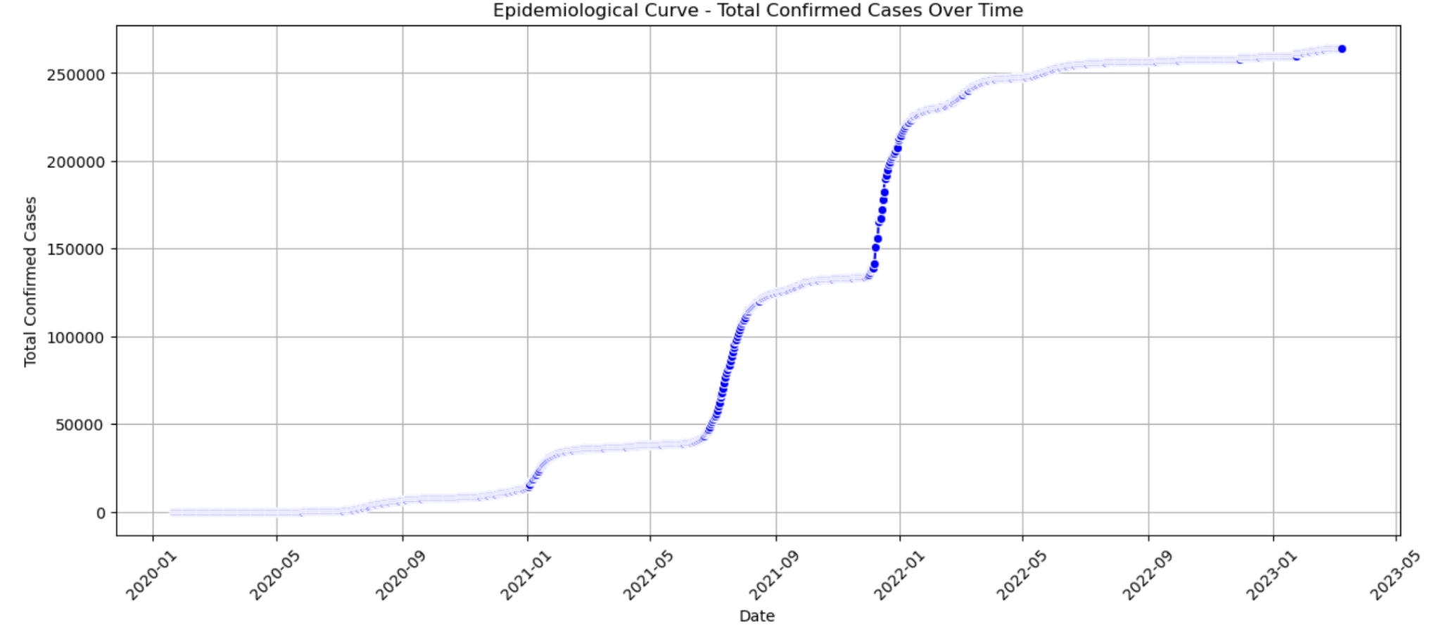
Epidemiological Curve
The epidemiological curve, often referred to as an "epi curve," illustrates the distribution of new cases over time. It helps visualize the pattern of disease spread.
The shape of the epi curve can reveal information about the outbreak's dynamics. A steep upward slope indicates rapid transmission, while a plateau or downward slope may suggest control measures are having an effect. Identifying the peak of the curve helps anticipate healthcare resource needs and plan interventions.

Slide 22
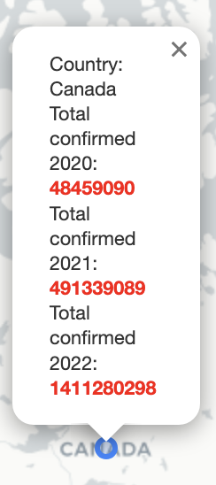
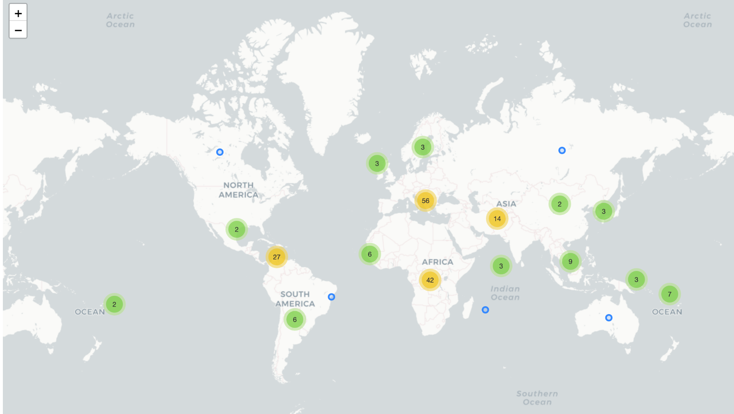
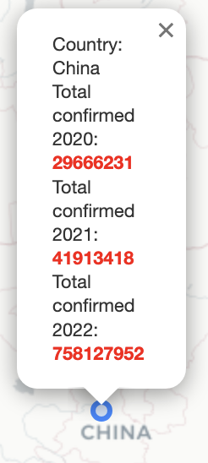
An interactive world map

Slide 23
Data Predict
Why Data prediction?
Data prediction offers valuable insights into future trends and patterns.
ARIMA, Autoregressive Integrated Moving Average Model as its full name, as a type of regression model, is aimed capturing sequential dependencies in time-series data. By leveraging historical information, ARIMA can learn complex patterns in the COVID-19 dataset, facilitating accurate predictions of future trends, which is essential for proactive decision-making and resource planning in the ongoing pandemic.
ARIMA

Slide 24
Prediction Workflow
time series number
Set Parameters
country
date
Select Data from country
filter data with corresponding dates
Assemble data into vector
Convert data into numpy
Prediction Function
Turn vector into numpy array
ARIMA model
prediction-true
true
show result and calculate error
Error:

Slide 25
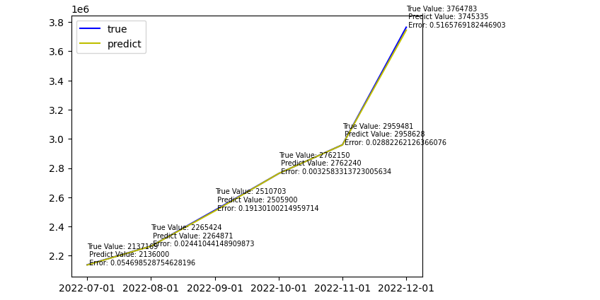
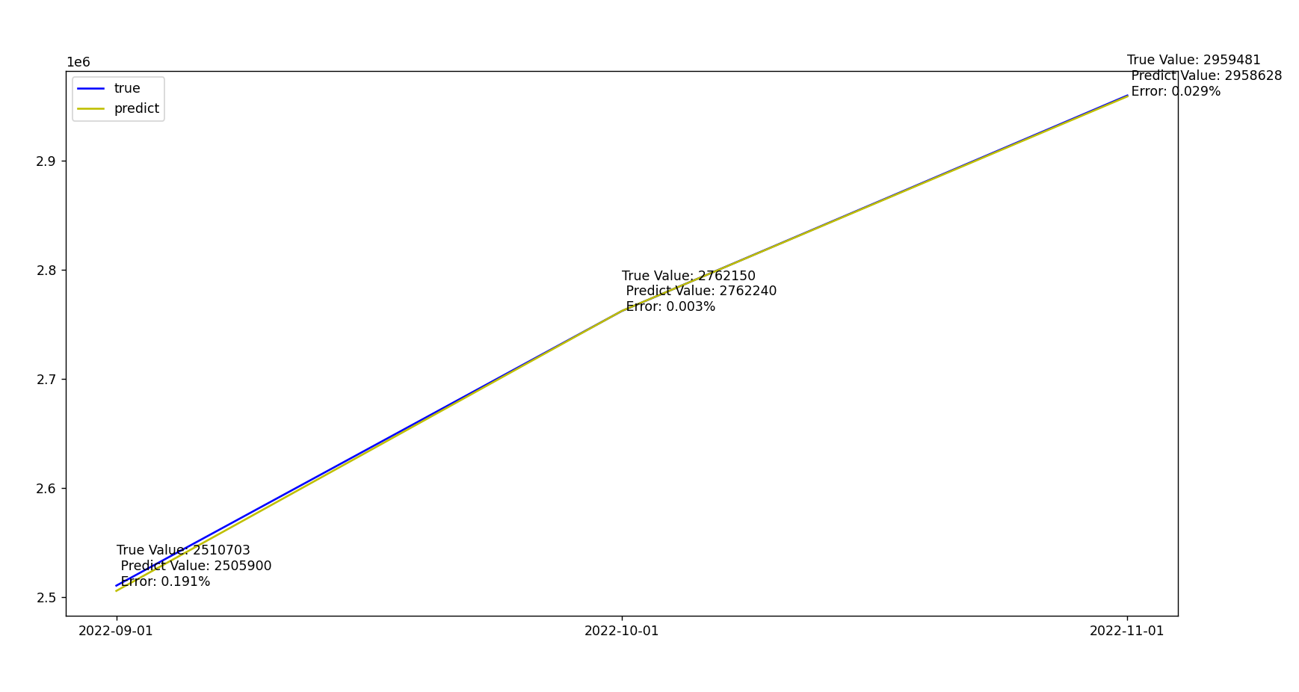
Prediction Results
Single Day Prediction
Multiple Day Prediction
2022-09-01
True Value: 2510703
Prediction Value: 2505900
Error: 0.191%

Slide 26
References
HDFS File System course slides, https://mycourselink.lakeheadu.ca/d2l/le/content/118186/viewContent/1724238/View
01 Install and Setup Apache Spark 2.2.0 Python in Windows - PySpark, https://www.youtube.com/watch?v=WQErwxRTiW0&t=1s
PySpark Tutorial, https://www.youtube.com/watch?v=_C8kWso4ne4&t=5398s
Piccolo, Domenico. "A distance measure for classifying ARIMA models." Journal of time series analysis 11.2 (1990): 153-164.

